Slide 1
Bioinformatic Analysis for Cancer Genomics
Course overview
15/12/2024
Phuc Loi Luu, PhD
Email: Luu.p.loi@googlemail.com
Zalo: 0901802182

Slide 2
Content
The Teams help US!
What we will learn from the course?
What you can do after the course?
Github and youtube

Slide 3
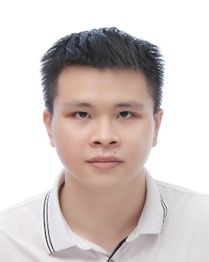


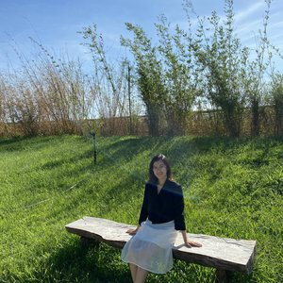




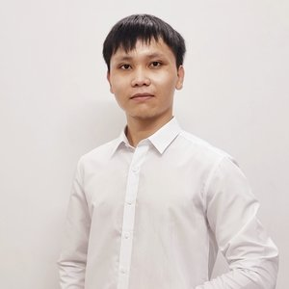
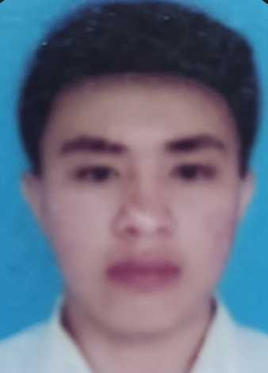

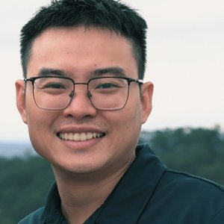


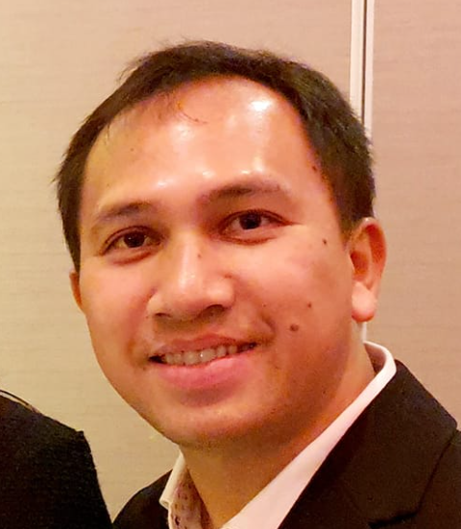
TEACHING ASSISTANT TEAM (TRỢ GIẢNG)
Nguyễn Quang Khải
nguyenkhai12330@gmail.com
Hà Gia Huy
hagiahuy311@gmail.com
Hồ Phú Quý
hophuquy0944@gmail.com
BS. Hoàng Sơn
hoangsonltt710@gmail.com
BS. Minh Nguyễn
ducminhnguyenle30091996@gmail.com
ThS. Nguyễn Quỳnh Như
Lucianhu@gmail.com
ThS. Trần Thị Mỹ Qui
ttmqui1912@gmail.com
Duy Đào
khuongduying@gmail.com
ThS. Ngô Đại Phú
phudaingobio@gmail.com
Nguyễn Mạnh Hùng
hungtrangan141@gmail.com
Lê Văn Giàu
lgiau6366@gmail.com
Phạm Văn Quan
quanpham0512@gmail.com
Hoàng Kim
vanhohoangkim@gmail.com
ThS. BS. Đào Ngọc Bắc
daongocbac2020@gmail.com
TS. Trịnh Vạn Ngữ
VNTrinh@mdanderson.org

Slide 4


LOGISTIC TEAM (HẬU CẦN)
Hoàng Kim
vanhohoangkim@gmail.com
Nguyễn Lê Quang
quanglequang2003@gmail.com
Lê Giàu
lgiau6366@gmail.com

Slide 5
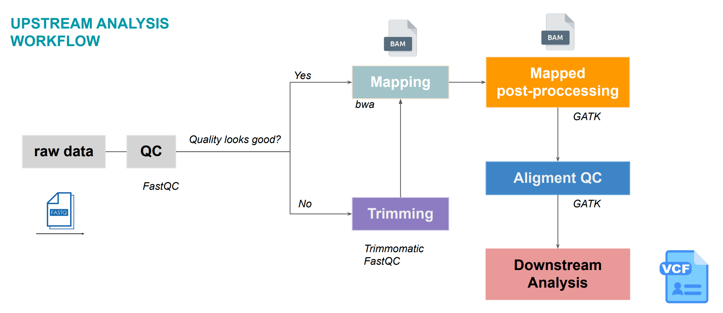
Adapted from Duy’s slide

Slide 6
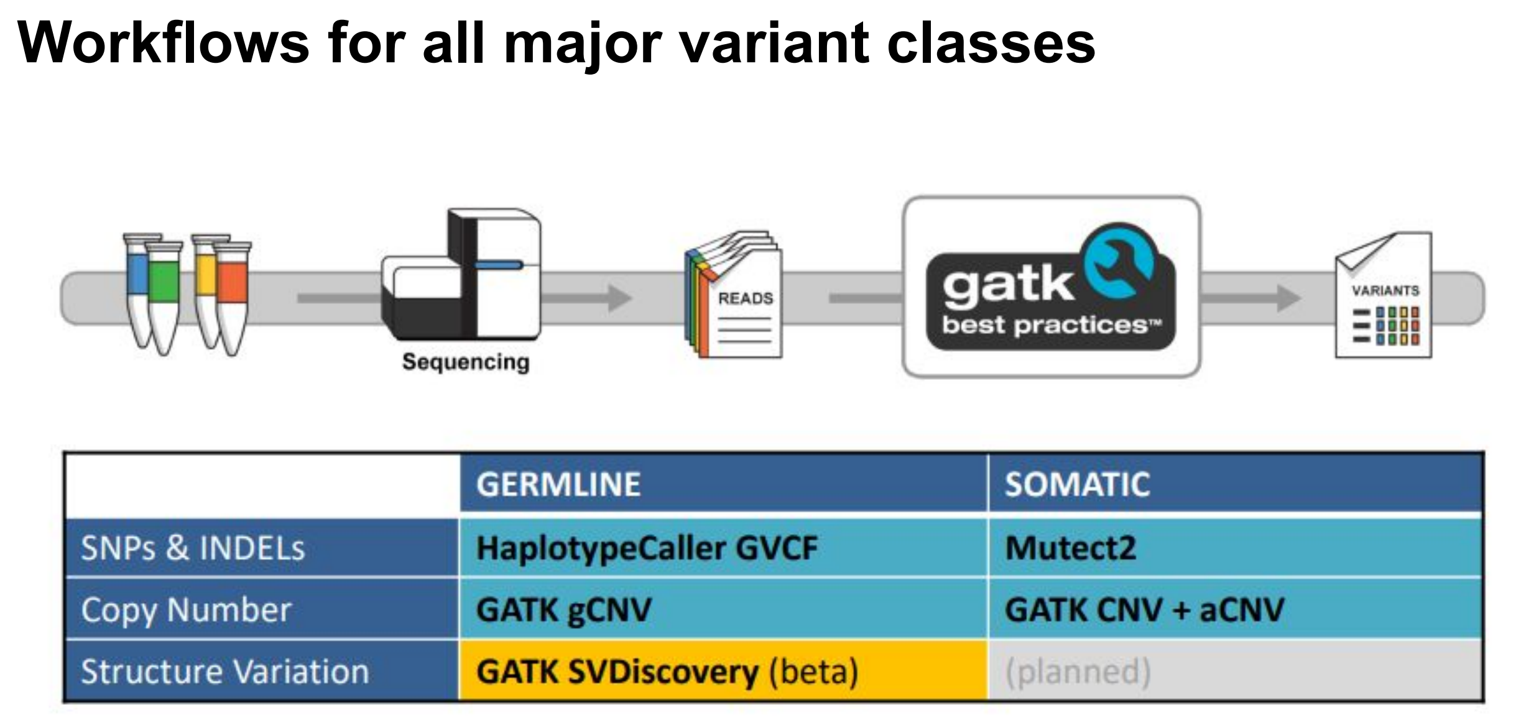
Adapted from Minh’s slide

Slide 7
Methods
No | Sequencing Platforms | Read mapping | Single Nucleotide Variant (SNV) Calling | Structural Variant (SV) and Copy Number Variant (CNV) Calling | Variant Annotation
1 | Illumina | BWA-mem, Bowtie2, SOAP2, Minimap2, BLASR, NGMLR … | SAMtools, Deepvariant, GATK, SpeedSeq … | DELLY, BreakDancer, LUMPY, GRIDSS, TARDIS, SURVIVOR, PBHoney, NanoSV, Manta, CNVnator … | HPO, ClinVar, Varsome, Gnomad, Cosmic, ANOVAR …
2 | Onso (Short read, PacBio) Revio (Long read, PacBio) |  | Mummer | AMOS assembly, assembler ALLORA, minimus2 and BLASTR
3 | Ion Torrent PGM | Bowtie2 | SAMtools | Velvet and Newbler
4 | MGI |  | Mauve | Newbler
5 | GeneMind | SMALT | SSAHA
6 | Aviti (Element Biosciences) | BWA |  | Ray Meta
7 | ONT
10.1186/s12864-024-10239-9 and 10.1186/s13059-019-1828-7

Slide 8
What we will learn from the course?
Install and use Ubuntu or Google Colab
Master programming language (Bash and R), Linux command line, and some bioinformatic tools
Manipulate Next Generation Sequencing data of DNA for both research and clinical application
Plot ready for publication figures and statistically analyzing for a manuscript
Downstream analysis of DNA-seq
Understanding publications of DNA-seq

Slide 9
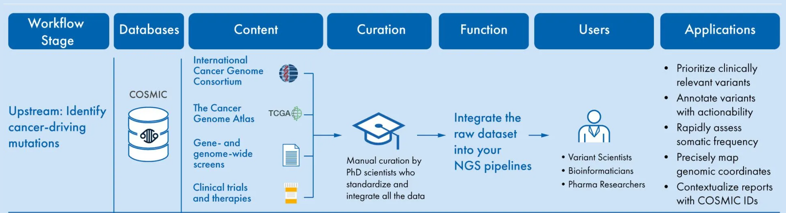
COSMIC for clinical NGS testing
https://digitalinsights.qiagen.com/somatic-mutation-databases-for-clinical/

Slide 10
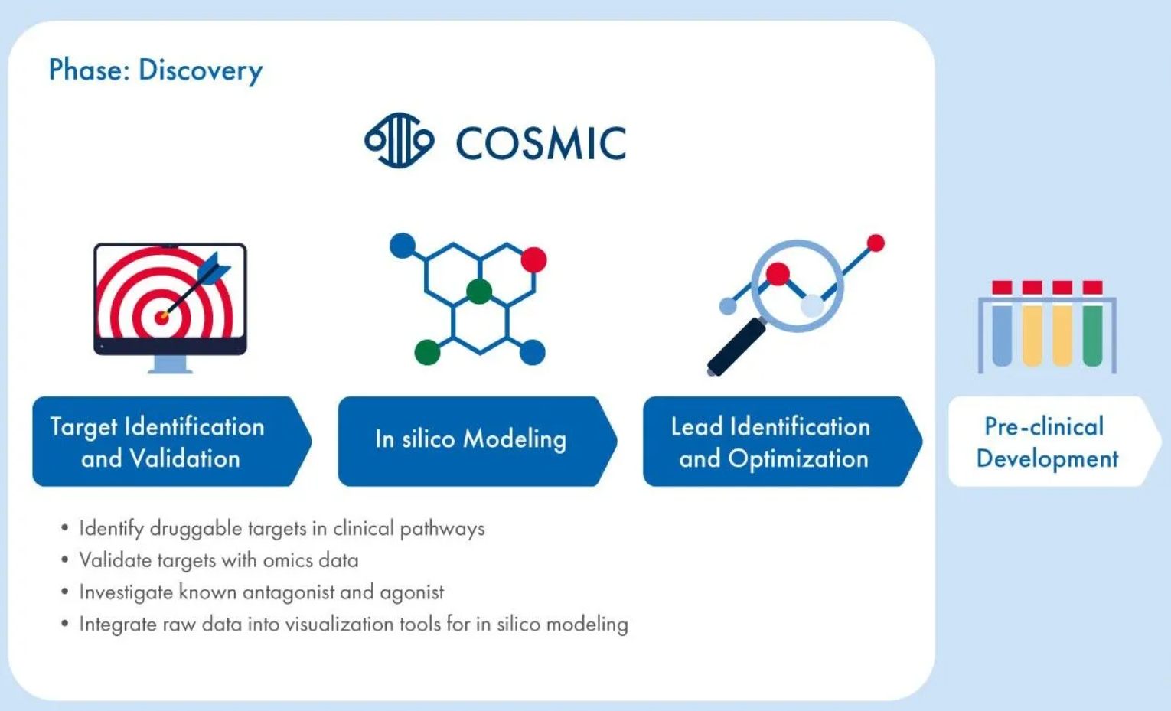
COSMIC in the cancer drug discovery
https://digitalinsights.qiagen.com/cosmic-hsmd-biopharma/

Slide 11
COSMIC in the cancer drug discovery
https://digitalinsights.qiagen.com/cosmic-hsmd-biopharma/

Slide 12
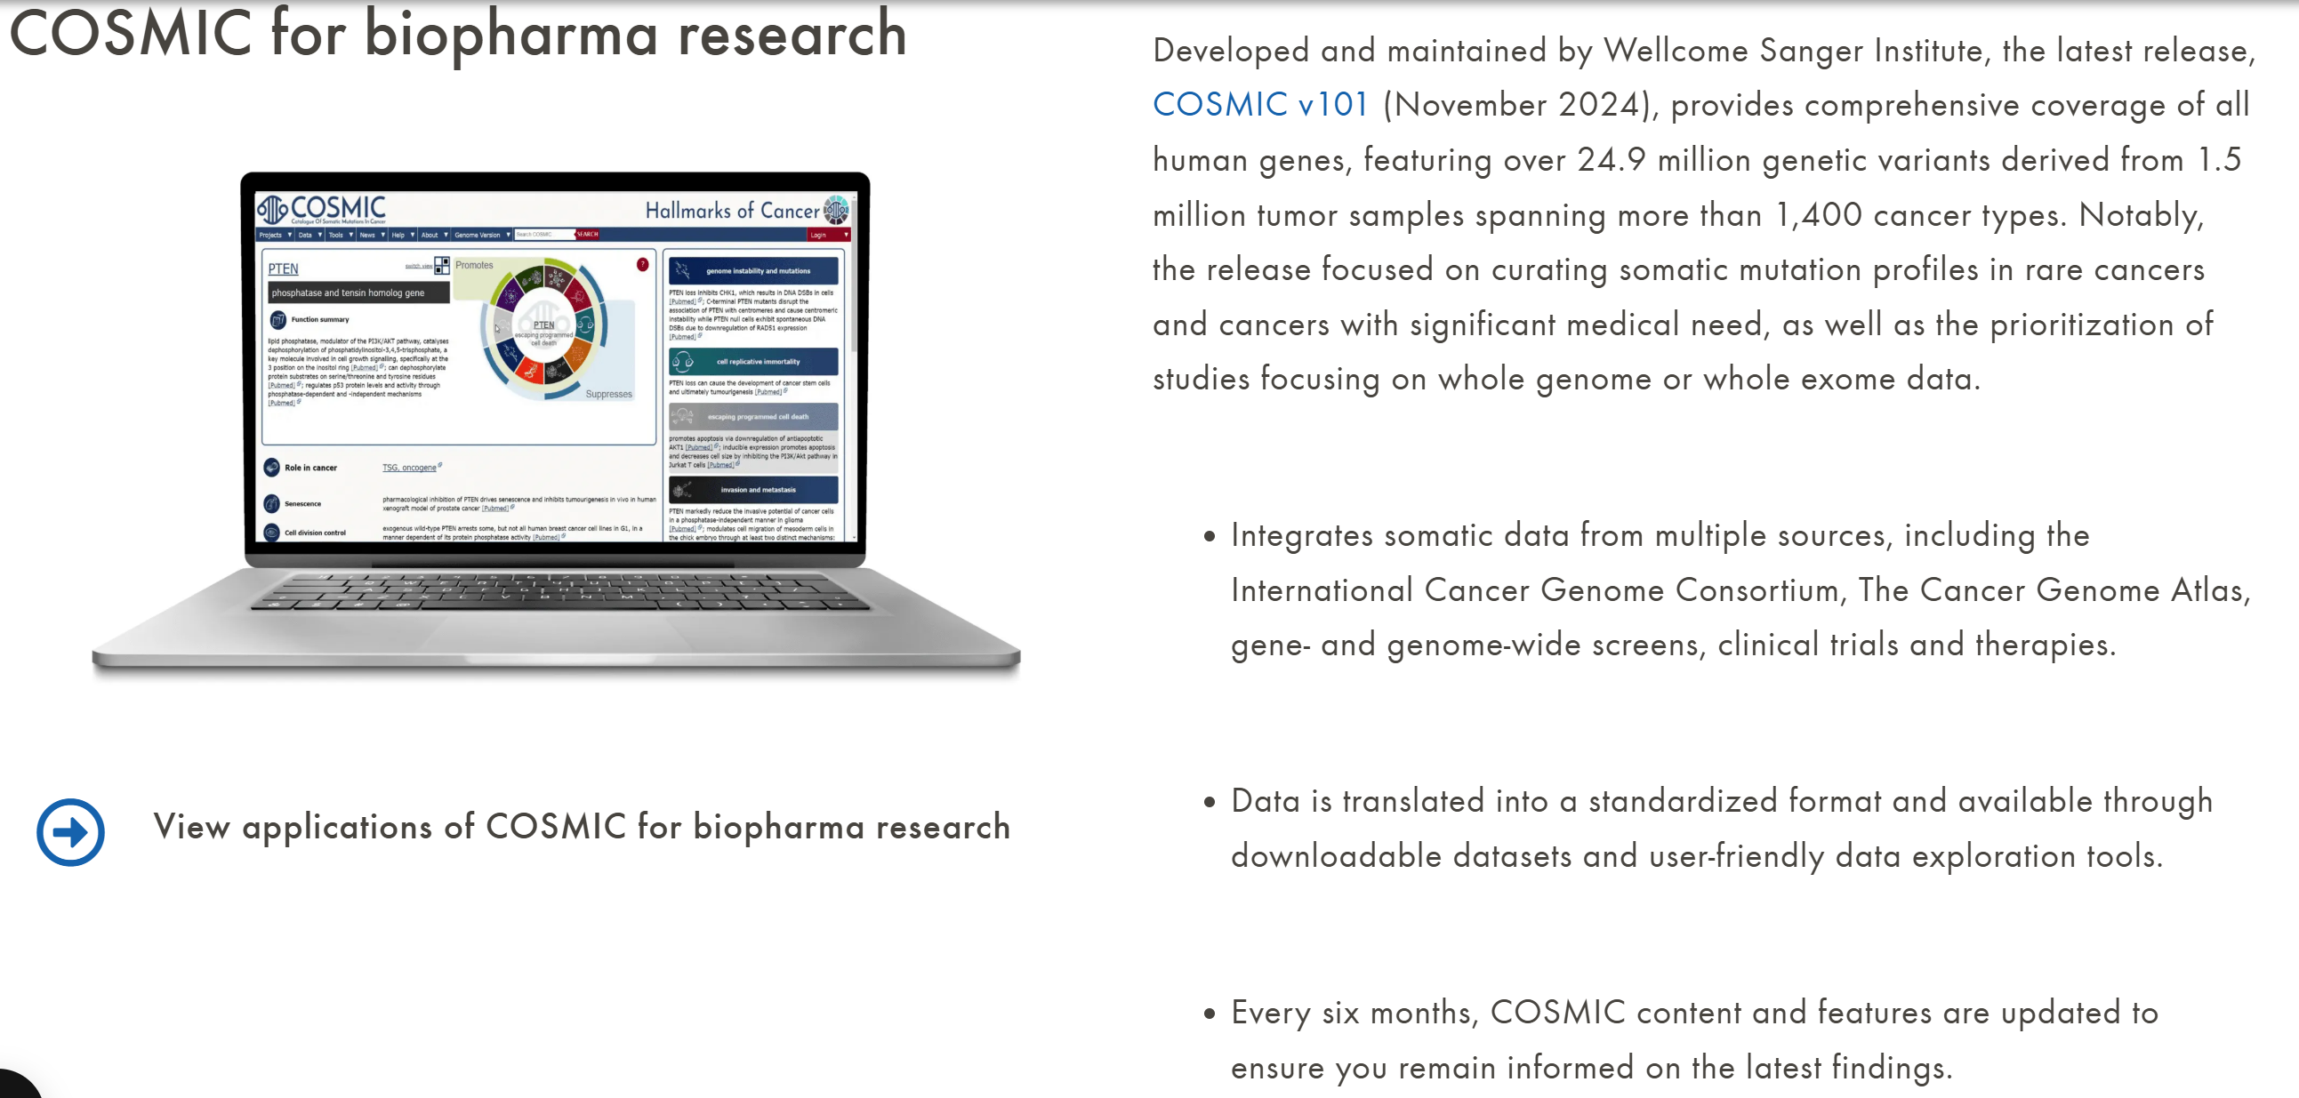
COSMIC for biopharma research

Slide 13
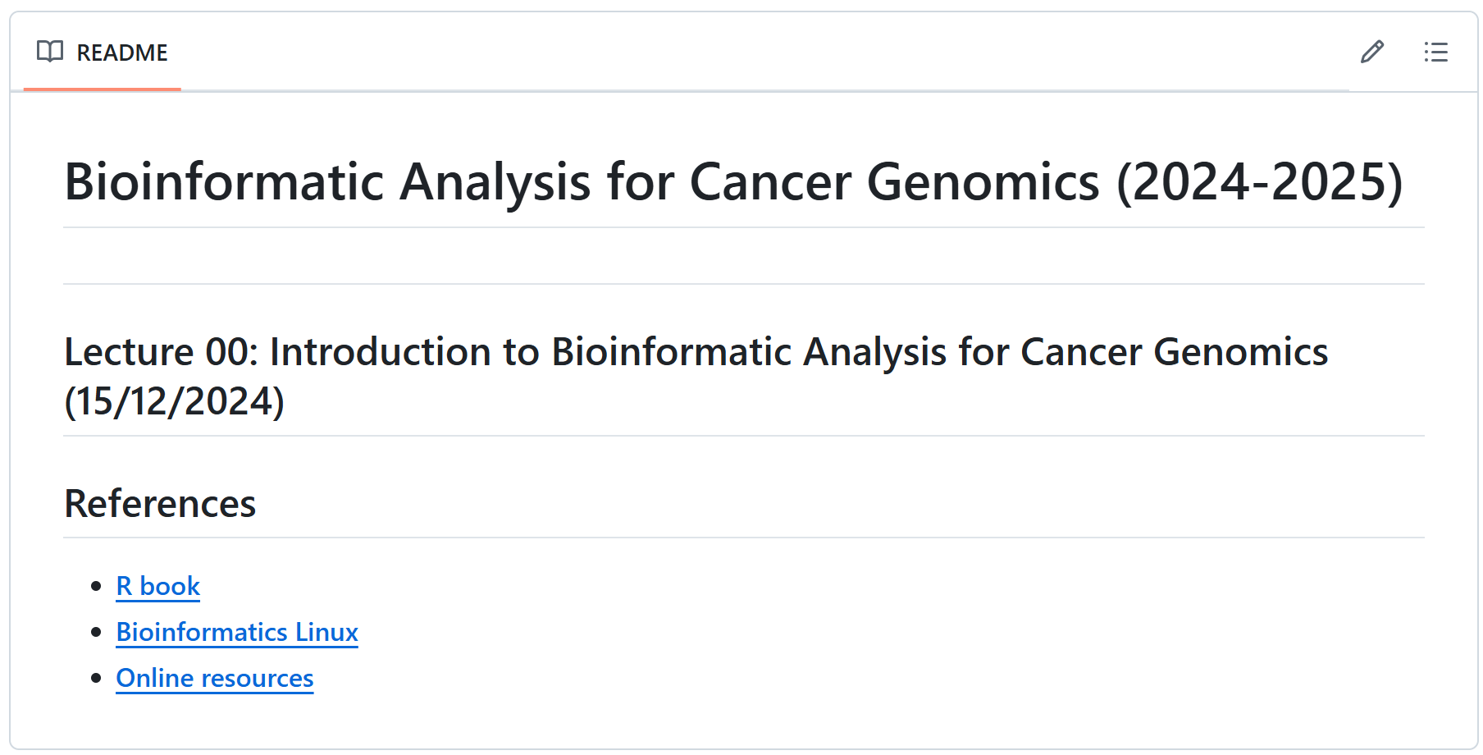
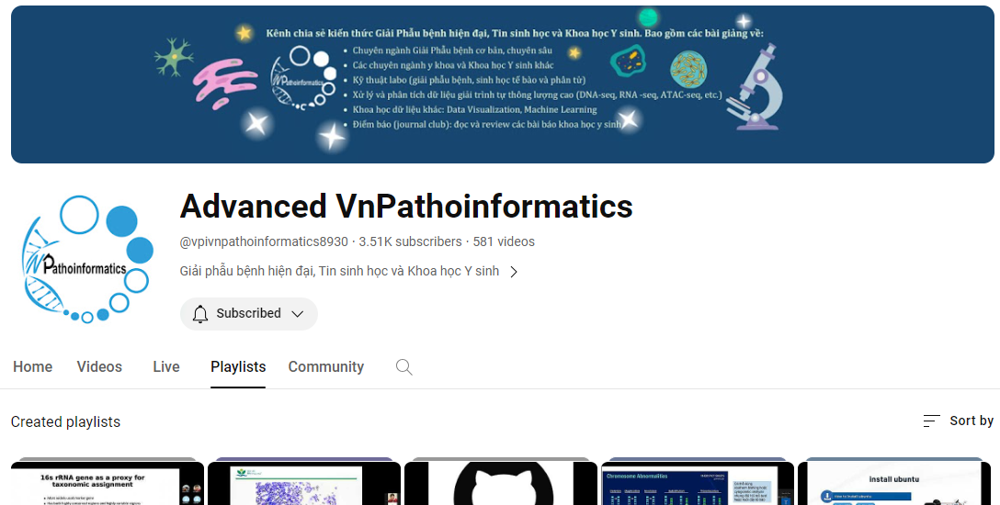
Github and youtube
Github: Lecture Slides, Exercises, Books and Q&A
https://github.com/luuloi/Bioinformatic_Analysis_for_Cancer_Genomics
2. Youtube:
https://www.youtube.com/@vpivnpathoinformatics8930/playlists

Slide 14
Thank you for your listening!

